Slide 1
SAP BTP Extension Suite Training
Day 4
Anubhav Oberoy
www.AnubhavTrainings.com
Follow excellence with sheer passion

Slide 2


DISCLAIMER
The training content and delivery of this presentation is confidential, and cannot be recorded, or copied and distributed to any third party, without the written consent of Anubhav Trainings

Slide 3
Agenda – Day 4
01
04
Introduction to CDS Views
Introduction to Fiori Elements
02
05
Business Application Studio
Adding UI module
03
06
Generic Service handlers & Test
Deploy App to CF

Slide 4
Introduction to CDS Views
1. Usually we have all our data distributed across multiple tables, and if we need to get this data out, we need to write complex queries with joins. It becomes very complex to handle the maintenance of these large queries. Views will simplify the consumption and make it easy to maintenance.
2. We can perform operations like aggregation on the view.
3. Security
4. CDS views are also the contracts for data consumption
5. They include annotations which drive functionality.
6. View provide lose coupling to load data. Whereas when we use queries and joins, they are always tight coupling.
Exercise:
https://github.com/soyuztechnologies/SAP_BTP_Training_CLD200/blob/master/Day%203/01%20db/01db/CDSViews.cds
Purchase order
Purchase order items
Load what is needed

Slide 5
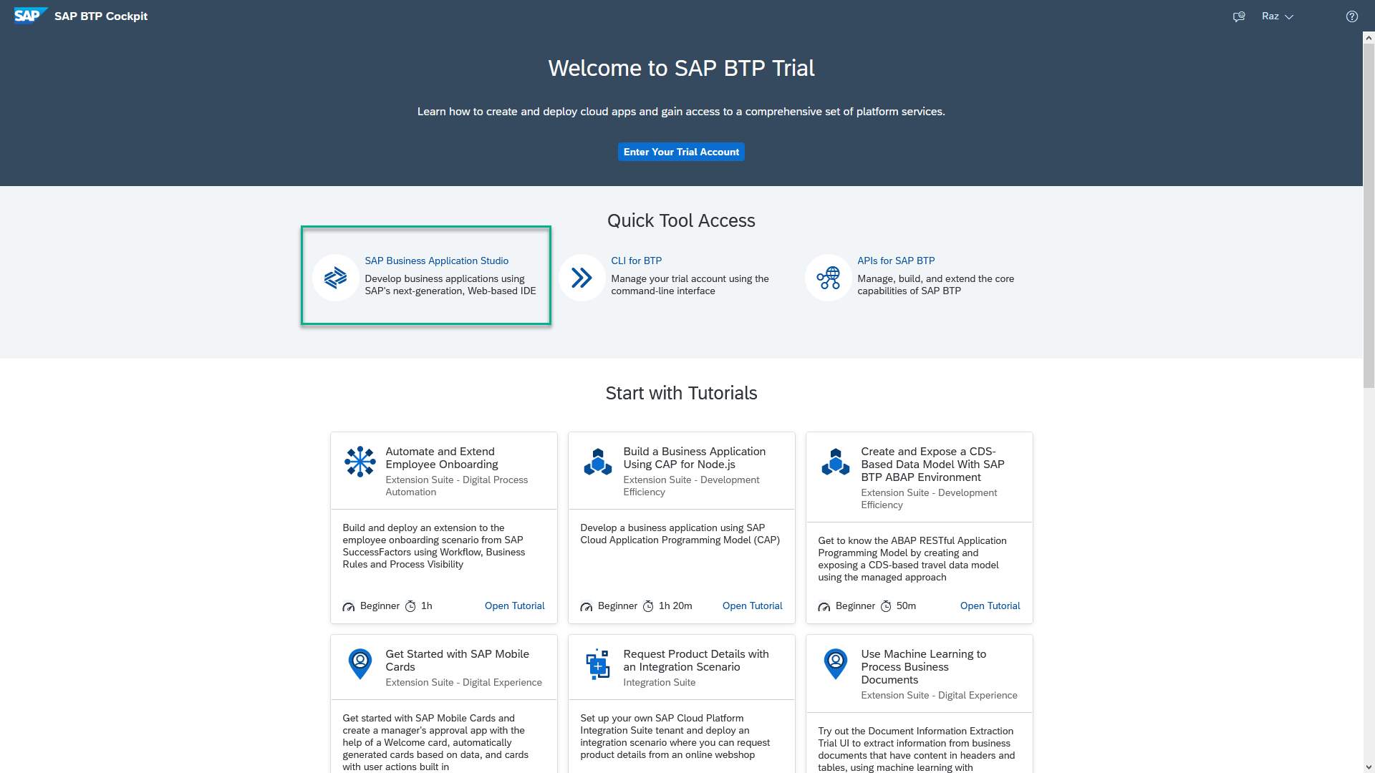
Business Application Studio
SAP Business Application Studio is a development environment available on SAP Business Technology Platform. Before you can start developing using SAP Business Application Studio, administrators must perform the required onboarding steps that are described in this tutorial.
In an Enterprise Account you can set up SAP Business Application Studio as a Free-Tier service by checking its free plan during its entitlement configuration.

Slide 6
Dev Space in BAS
VM
2GB
Dev Space
@cds/dk
VM
2GB
Business Application Studio
PaaS – BTP – Manager of this entire infrastructure
IaaS – AWS – Computer Running on internet
Bunch of servers with hardware – 1000 GB

Slide 7


Hands on: Move App to BAS

Slide 8
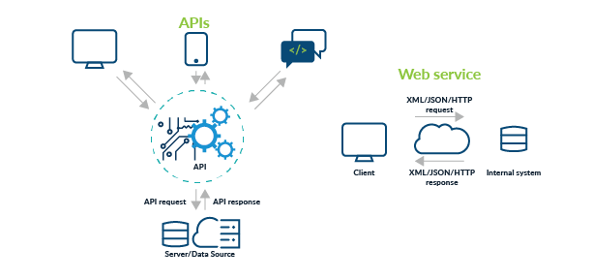
Testing Services in BAS
Exercise:
https://github.com/soyuztechnologies/SAP_BTP_Training_CLD200/blob/master/Day%203/02srv/tester.http

Slide 9
Actions and Functions
In addition to common CRUD operations, you can declare domain-specific custom operations as shown below. These custom operations always need custom implementations in corresponding events handlers.
Actions vs Functions
The differentiation between Actions and Functions stems from the OData specifications and in essence is as follows:
Actions are meant for operations, which add or modify data in the server; they are called through POST request with the arguments passed in application/json bodies.
Functions are meant for operations, which only retrieve data from the server; they are called through GET requests with the arguments passed in the URL path.
Exercise:
https://github.com/soyuztechnologies/SAP_BTP_Training_CLD200/blob/master/Day%203/02srv/CatalogService.cds
https://github.com/soyuztechnologies/SAP_BTP_Training_CLD200/blob/master/Day%203/02srv/CatalogService.js

Slide 10
Generic Handlers in CAP
The CAPM framework generates most of the code to perform CURDQ operations on the entity. It does not know what validations to perform on our business data. As a developer, when we want to attach a pre-check (validations) / post-check (post processing code) on an entity operation, we can use generic handlers. All these operations are performed SYNCHRONOUSLY.
At times we want to
Take full control of our implementation
We want to add some validation before data is inserted or updated
We want to change data before insert/update
Read some extra information while GET calls
Fiori app
odata
cap
Generic handlers
database
before
on
after

Slide 11

Hands on: Generic Handlers

Slide 12
Exercise – generic handlers
Exercise:
https://github.com/soyuztechnologies/SAP_BTP_Training_CLD200/blob/master/Day%203/02srv/MyService.cds
https://github.com/soyuztechnologies/SAP_BTP_Training_CLD200/blob/master/Day%203/02srv/MyService.js

Slide 13
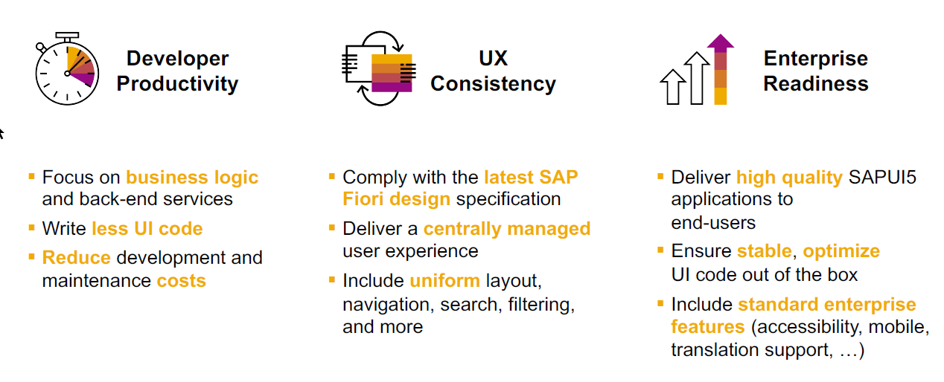
SAP Fiori elements boosts SAP Fiori development efficiency

Slide 14
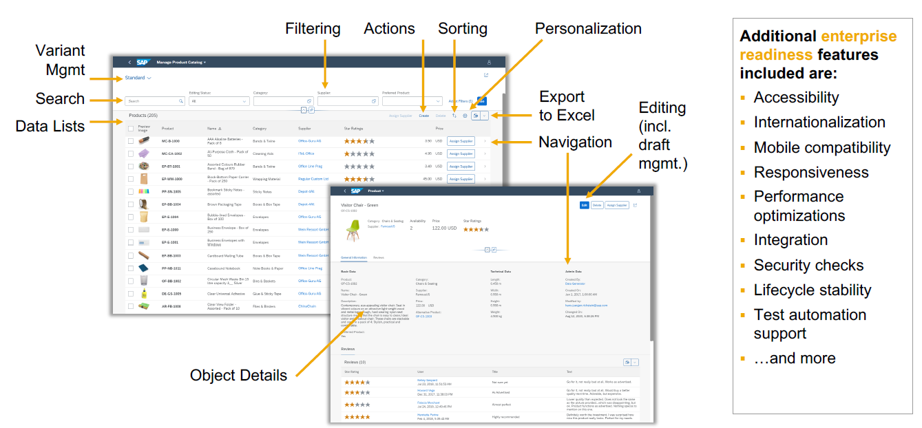
SAP Fiori elements provides enterprise-ready apps out of the box

Slide 15
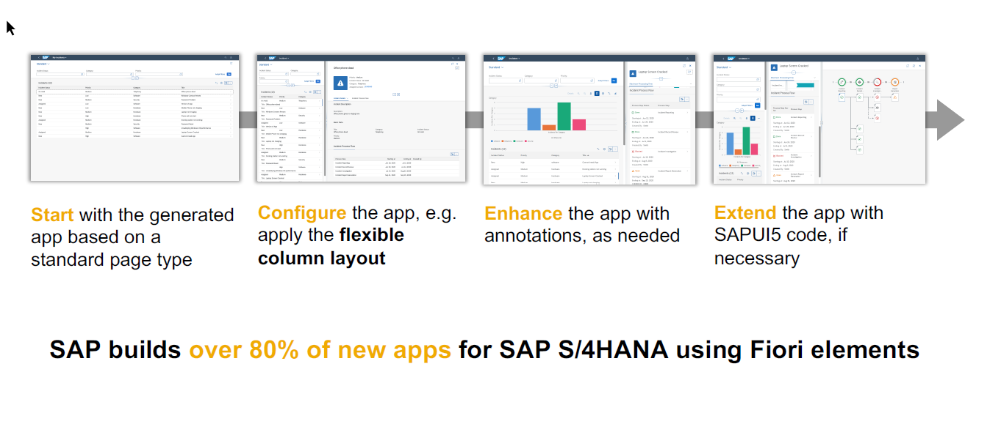
SAP Fiori elements application architecture provides flexibility

Slide 16
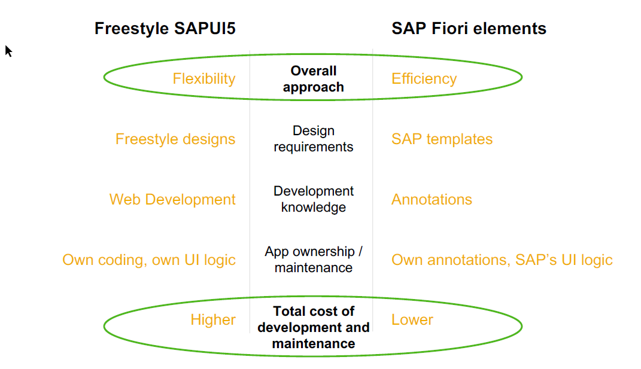
SAP Fiori elements prioritizes efficiency over flexibility

Slide 17

Hands on : Fiori App

Slide 18
Create Fiori App using Annotation
Exercise:
https://github.com/soyuztechnologies/SAP_BTP_Training_CLD200/blob/master/Day%203/03%20application/03application/app/purchaseorderapp/annotations.cds

Slide 19
Association v.s Composition
Association – a relationship between entities which is a lose coupling. Both objects should exist together. However, they can work independently. Airplane and passenger.
Composition – a relationship between entities which is a tight coupling. Both objects must exist together. They cannot function independently. Airplane and wings.
Purchase Order Header
composition
Purchase order Items

Slide 20

Hands on: Create & F4 Enablement for app
Solution

Slide 21
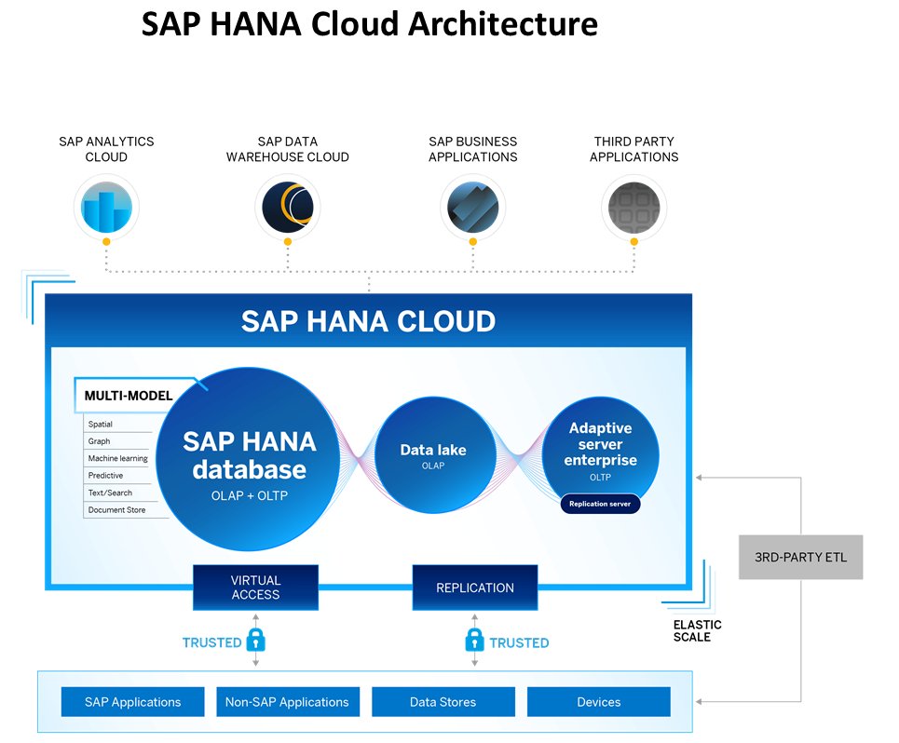
Introduction to HANA Cloud
SAP HANA Cloud is a fully managed, in-memory, cloud database as a service (DBaaS). It is the cloud-based data foundation for SAP Business Technology Platform. With SAP HANA Cloud you can create, run, and extend new and existing applications.
SAP HANA Cloud includes a number of software components. The core component is SAP HANA Database, but other components can be added at any time, such as a data lake.
Key Components of SAP HANA Cloud
There are four key components of SAP HANA Cloud:
SAP HANA Cloud, SAP HANA Database
In-memory database with built-in advanced analytics (spatial, graph, text, etc.)
SAP HANA Cloud, data lake
Store and query large data sets and most file types
SAP HANA Cloud, adaptive server enterprise
Support for extreme –performance transactional applications
SAP HANA Cloud, adaptive server enterprise replication
Bi-directional real time data replication across databases

Slide 22
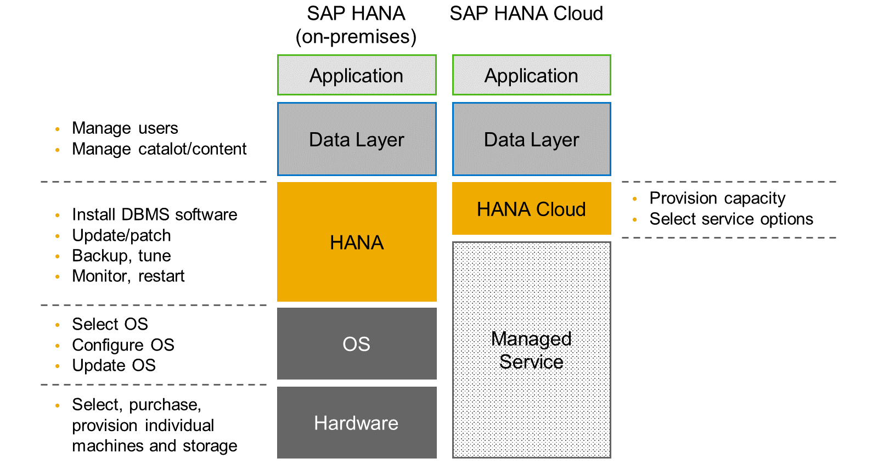
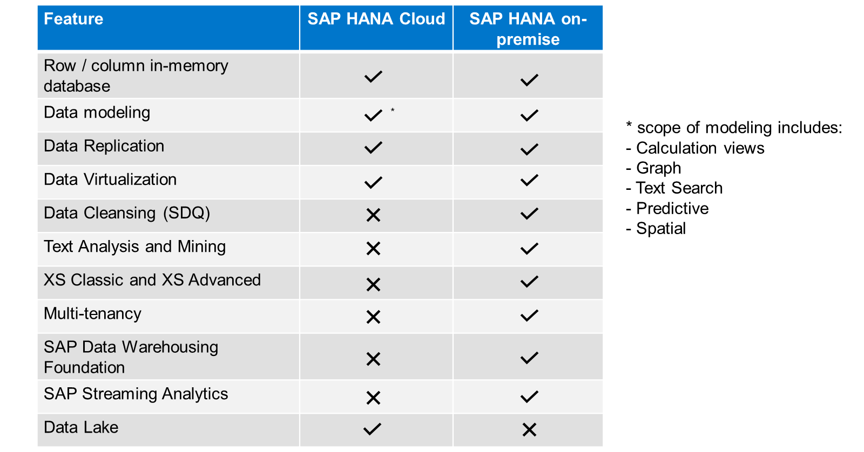
HANA Cloud v/s On-premise
Feature Differences
SAP HANA Cloud compares very closely with SAP HANA on-premise in terms of features but there are some differences.

Slide 23
What is Schema in HANA
Schema – Is a mandatory database object of database which stores other database objects.
It’s a logical separation of database objects.
It is home of all the runtime object
Security
BW
ekko
ECC
ekko
S/4HANA
ekko
Non-SAP
SAP HANA 600GB
SCBW
ekko
ECC001
ekko
SAPS4C
ekko
MIG
ekko
SYS

Slide 24
HDI Container
An HDI Container is also a schema. But it is managed differently from a normal schema.
Schema -- How its created?
Manually create it in BTP
Application Managed HDI Container (You as developer ONLY work with App, App will talk to HANA to create and manage this schema to store/read data internally)
You cant access HDI Container using HANA Studio (Deprecated tool), We can use new SAP HANA Database Explorer, SAP HANA WebIDE for OP or BAS to access HDI Container.
HDI -- Who creates it?
There is a new service in SAP HANA called SAP HDI (HANA Deployer Infrastructure) which is just a microservice responsible to managing the container. HDI Deployer is a component which is used to talk to this service from our app.

Slide 25
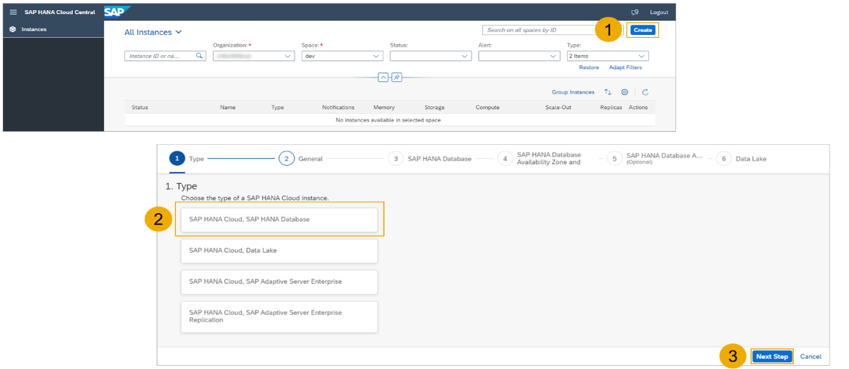
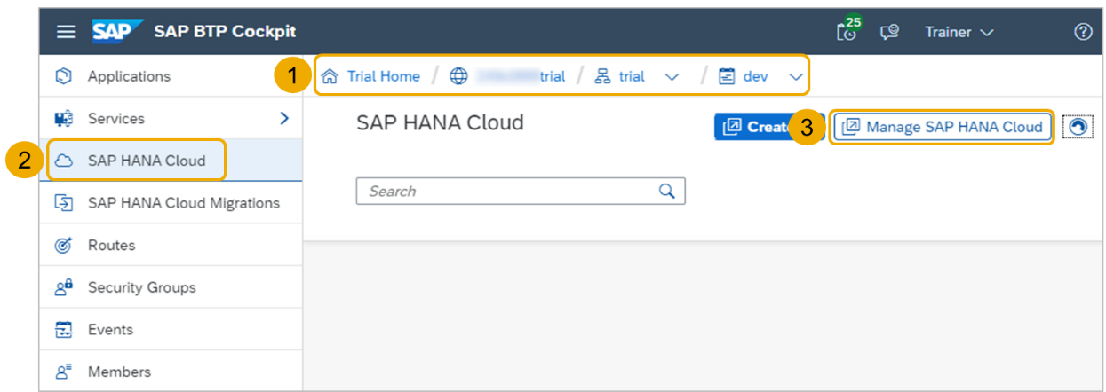
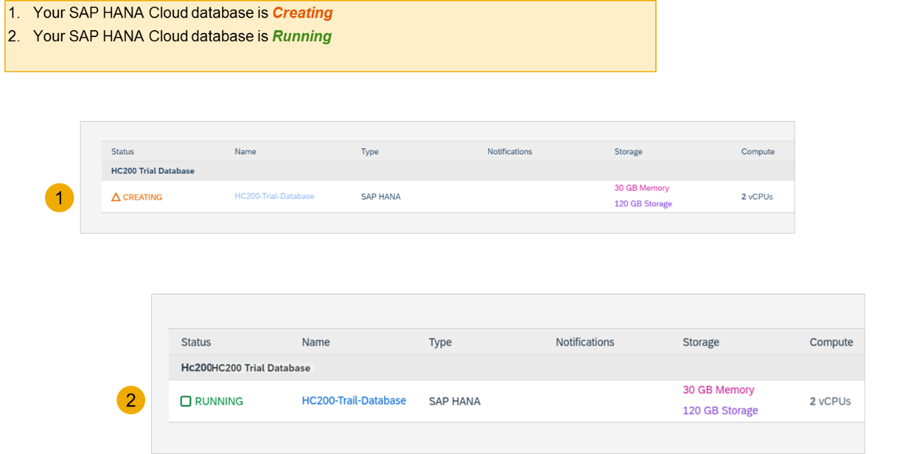
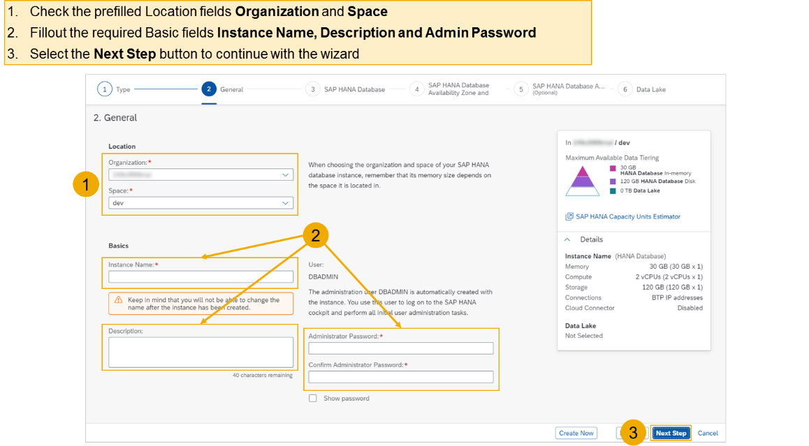
Hands on - Create HANA Cloud Instance
Login to your trial and navigate to your dev space
Select SAP HANA Cloud
Select the Manage SAP HANA Cloud button to start the SAP HANA Cloud Central
Select the Create button to start the wizard
Select the SAP HANA Cloud instance Type to create
Select the Next Step button to continue

Slide 26
Hands on – HANA Cloud Integration
Pre-requisites
Check the version of CDS (which must be > 2.0) cds –v
Start a HANA cloud instance in SAP BTP
Main steps
Add hana configuration to our app, which tell cap framework that the default db is now hana – cds add hana
2. Add the hana specific deployment format name to our project under cds section as below inside package.json file "hana":{
"deploy-format":"hdbtable"
}
3. Since the first step added the hdb node module, we need to install it. Run npm install
4. We need to perform a build, which will create all the hana specific files which will be deployed to HANA cloud. cds build --production
5. We need to login to cloud foundry from BAS – cf login
6. Finally we need to deploy the DB and everything to SAP HANA Cloud – cds deploy --to hana:batman
7. We fixed issues related to excel format of HANA and changed the size of field bankid for employee, redo the build and deploy
8. If deployment worked, a new file cdsrc-private.json gets created automatically, this file contain the information about which container in SAP BTP HANA Cloud to connect to. And the private key is stored in this file.
9. Provide the credentials which will be used to connect database, start using cds watch --profile hybrid
"credentials": {
"database": "batman-key"
}

Slide 27
Hands on : Deploy Application to BTP
First add the mta.yaml file, MTA – multi-target application which is an advance version of manifest.yml file which we used in past.
We use SAP provided CLI for MTA, this is pre-installed in BAS, tool is called mbt
First we run command cds add mta
We will add our UI module to the mta.yaml file manually, copy the srv entry and add the ui module.
- name: cappo-ui
type: nodejs
path: app
parameters:
buildpack: nodejs_buildpack
build-parameters:
builder: npm-ci
requires:
- name: srv-api
Inside the app folder, add the package json using npm init and add the app router module npm install @sap/approuter.
Add the start script "start": "node node_modules/@sap/approuter/approuter.js"
Add the xs-app.json, provide the routes and the end points
Open MTA editor and configure srv-api destination
Right click on mta.yaml file and choose build mta archieve this will create a mtar file for us

Slide 28
Authentication v/s Authorization
Authentication – It ensures that is our user a valid user? Has he/she entered valid credentials to login to our app. It is enforced by a login screen. This login screen can also come from IDP like SSO, LDAP, Social integration.
Authorization – Once user is authentication, then the authorization comes into play. It ensures, is our user allowed to do certain activities inside app. What is the level of access. E.g. create, update, delete, approve, view.
SAP BTP cf environment has a special component called XSUAA –
XS – eXtended Services
UAA – User Account and Authorization
This is an in-built component inside of CF
It is responsible to control the user account and authorization
It manages our application security
In CF we use modular approach to address security
As a developer we need to decide what roles and level of security we need in our app. Example, we need to secure odata resource /Anubhav.svc
Usually we define Viewer, Editor
We need to define our scope and role templates inside a special file called xs-security.json file
XSUAA Communicates to the IDP – Identity Provider
Issues JWT (JSON web Token) to cloud foundry router which let user access the app based on permission.
Scope
(Role)
* *
Role Template
* *
Role Collection

Slide 29

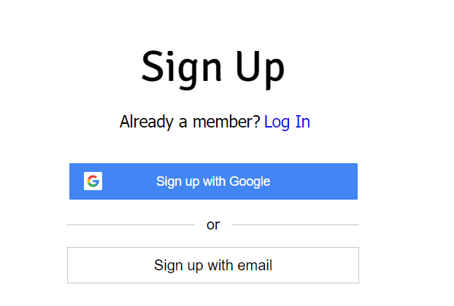

IDP – Identity Provider
An identity provider is a software or group of software which stores all the user credentials and their scopes (roles) in itself. This will centralize the user management in company and simplify the login process to different apps. This way user do not need to remember multiple passwords to multiple apps.
Portal
Launchpad
Dedicated SRM
SSO
SAP Server
GSuite
LDAP
User/email/password
Single source of truth
Trust relation
Scope- clerk, manager, ceo
Outlook
Our cloud app
xsuaa
XSUAA

Slide 30
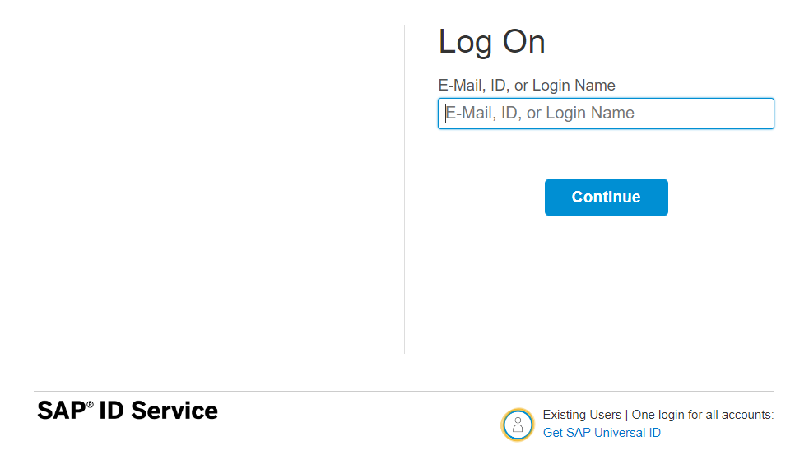
How it works behind scenes
xs-security.json contains information which we need to register to define what are all permissions required in our app
JWT
App
Browser
postman
code
ourxsuaa
trust
JWT
XSUAA
Scope
SAML
trust
IdP

Slide 31

Hands-on Add Security and Test Microservice
Solution:
https://github.com/soyuztechnologies/BTP_Architect_Training/blob/master/Day%203/01mtdbservice.zip

Slide 32
Testing the Microservice from postman
After the deployment, we open the postman tool and try to access resource with URL /vendor url, it gives unauthenticated.
We need to obtain access token so we went to authorization table and added the OAuth2.0 option and provided
Properties | Value
Token Name | BTPJWTToken
Grant Type | Password credentials
Access Token URL | Service key of xsuaa – url, append /oauth/token
Client Id | Service key – client_id
Client Secret | Service key – client_secret
Username | Our BTP account user id
Password | Our BTP account password
3. Call get token and choose use token button once token was fetched.
4. Again make get request for /vendor, and we should get response.
5. If we try /vendor/, it will not work because, we are looking for Role.
6. Went to BTP subaccount and created a Role collection, added the role template and assign same to our user
7. Again get the token and try to access end point for OData, this time it works.

Slide 33
Challenges in Current Approach
Did you notice, that we need to first pass lots of technical details from service key
Pass all the info in correct manner to postman to obtain token
Once the token expired, we need to reobtain again and again
Our end user do not know all this. Automate the XSUAA JWT token processing.
In our app, we will have multiple microservices, like java, sap ui5, node app, xsuaa…
Each service produce one end point e.g. /vendors, /index.html, /customers, they all logically belongs to same app. Will you give 3 url to our user to access these apps?
These microservices also needs to communicate with each other. Provided we give a single end point to access our entire app to end user.
We want to complete redirect mechanism to let user go to login screen, authenticate on IDP and exchange of all the tokens should be seamless behind the scenes.
We need a single entry point for entire app, forwardAuth tokens should be done automatic.
url
Application router
(Provide single entry point, exchange auth token,
Communicate between microservices, like a facade)
xsuaa
Java
/Anubhav.svc
UI5 App
/index.html
Node
/customer

Slide 34
Introduction to App Router
It is a Node JS Application
It is used to automate the process of authentication, authorization with XSUAA to do token exchange
It sits in the middle of IDP and XSUAA, it will redirect the request to our microservice to xsuaa, and eventually to idp
IDP sends the login screen to the user, user authenticates, which is taken to XSUAA, XSUAA issues JWT Token, this JWT token is presented to api end points
App Router takes the JWT token from XSUAA and gives it to our microservices and even exchange this token to multiple microservices inside
It Serves as a single entry point for the entire app.
To tell app router about our multiple microservices so that it can re-direct, we need to create a configuration file named as xs-app.json which contains the details.

Slide 35



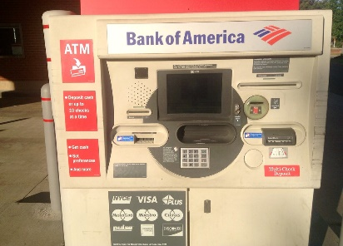
Real World Example
Customer
1
5
4
2
Loan
Credit Card
6
Validate, trust
Deposit
Draft/Cheque
3
FD
*******
7
Locker
This Photo by Unknown Author is licensed under CC BY

Slide 36
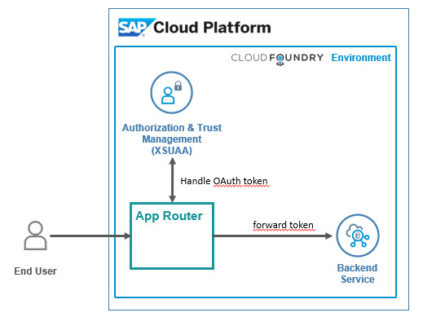
Hands on: App Router
Solution
https://github.com/soyuztechnologies/BTP_Architect_Training/blob/master/Day%203/04approuter.zip

Slide 38

What We Did
Let’s Summarize

Slide 39

www.anubhavtrainings.com
Thank You
End of Day 4

Slide 40


We’re committed to empower you to be
#FutureReady
through powerful training solutions.
We build the workforce of the future.
250+
Corporate Clients
50,000+
Learners Trained
25000+
Learners Placed
FREE WEBINARS
Sign up for free webinars with industry experts every fortnight!
Enroll Now!
Contact us today!
https://anubhavtrainings.com

Slide 41
Agenda – Day 4
01
04
Introduction to HANA Cloud
Identity Provider
02
05
Connecting to HANA Cloud Instance
JWT Token and Application Router
03
06
Authentication v/s Authorization
Deploy App to CF

